Slide 1
Revision

Slide 2
Now while you are working on your Investigation 1 (Pool design) and before we start our next topic, you need to do some 24-7-30 revision. Use your formula card to help you. Test 1 will include this measurement unit as well as our next unit on right-angled triangles- Check your assessment planner that is glued into your INB’s

Slide 3
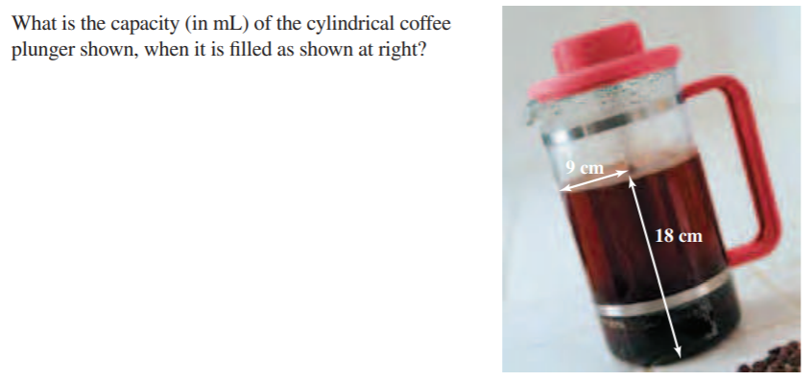
Mid point check- grab your whiteboards

Slide 4
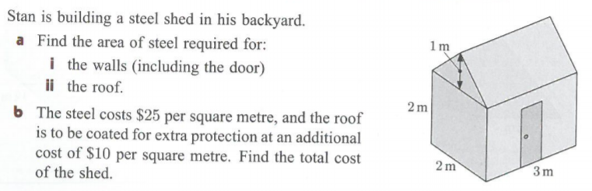
Exit pass- grab your whiteboards
2.5m
a) walls 20m2 roof 17m
b) steel for walls $500 steel for roof: 17x 35= $595

